Slide 1
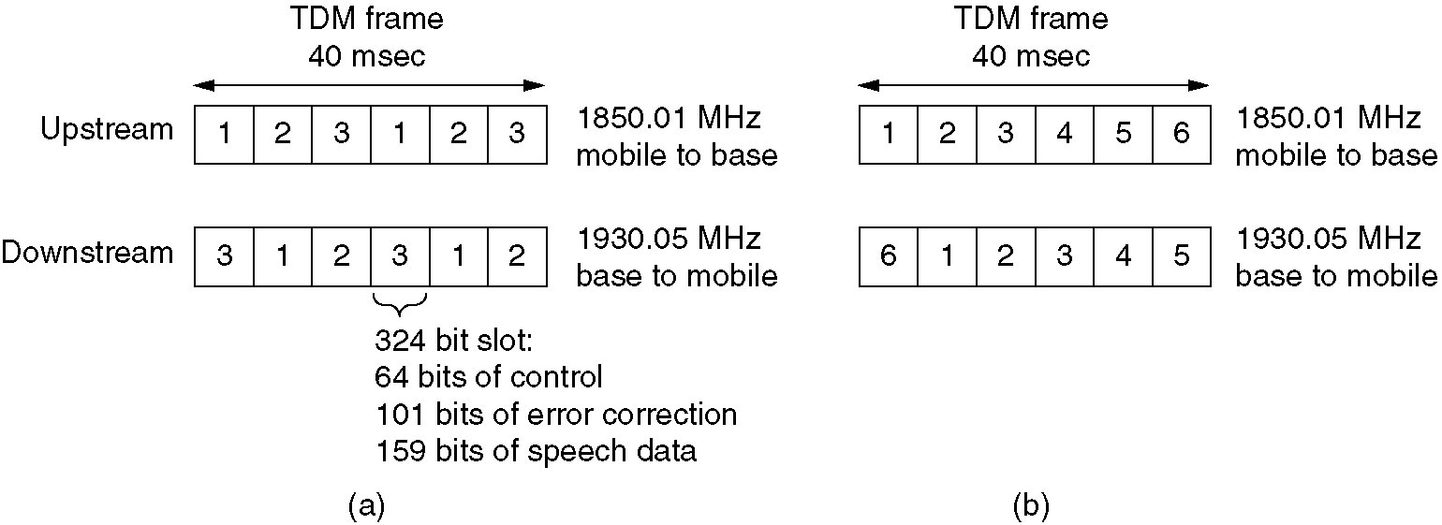
Digital Advanced Mobile Phone System (D-AMPS)
A D-AMPS channel with three users

Slide 2
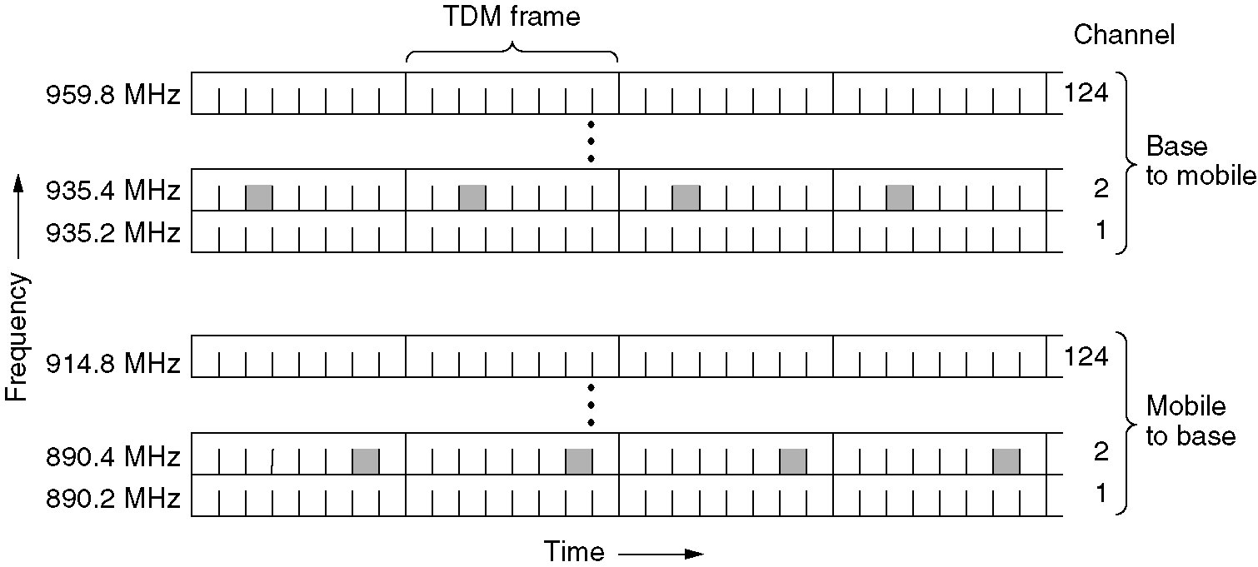
Global System for Mobile Communications (GSM)
8 shaded slots belong to same connection (4 in each direction)

Slide 3
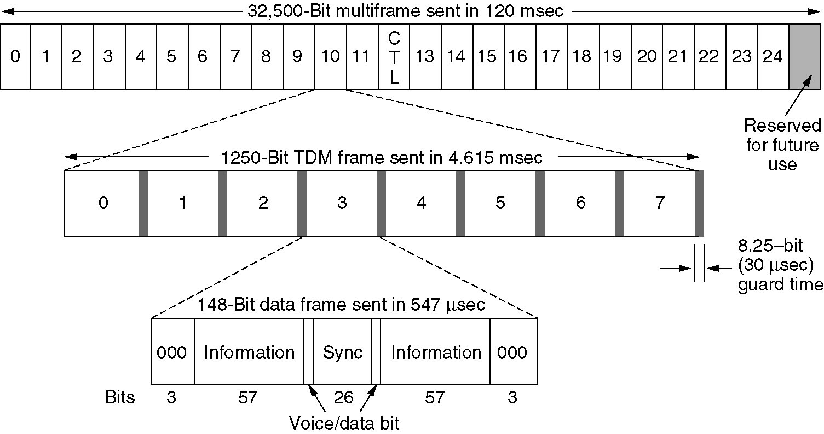
Global System for Mobile Communications (GSM)
Each TDM slot consists of a 148 bit data frame that occupies each channel for 577 μsec
  Each frame starts and ends with 3 0s

Slide 4
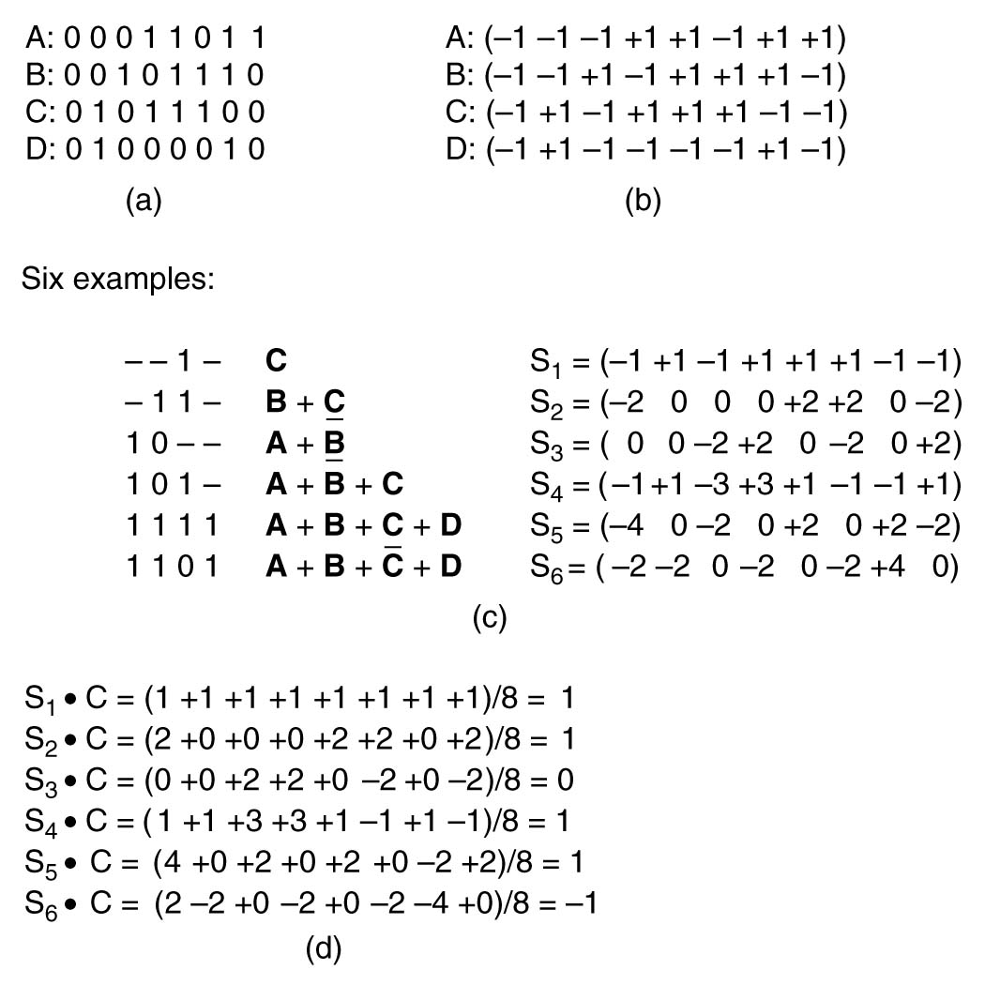
Code Division Multiple Access (CDMA) Access
Bipolar notation
0 => -1
1 => 1
(a) Binary chip sequences for four stations
(b) Bipolar chip sequences
(c) Six examples of transmissions
(d) Recovery of station C’s signal

Slide 5
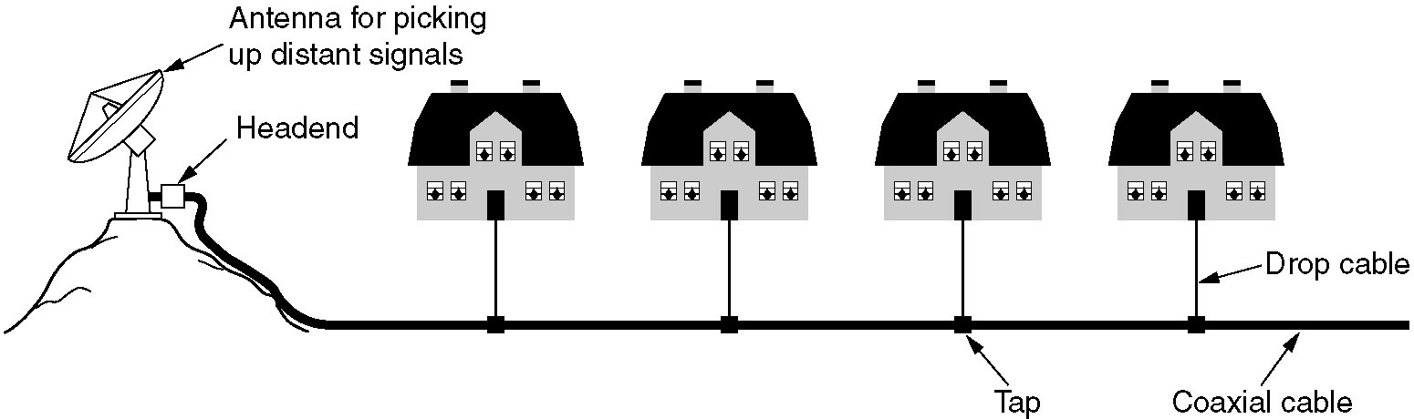
Community Antenna Television
An early cable television system.

Slide 6
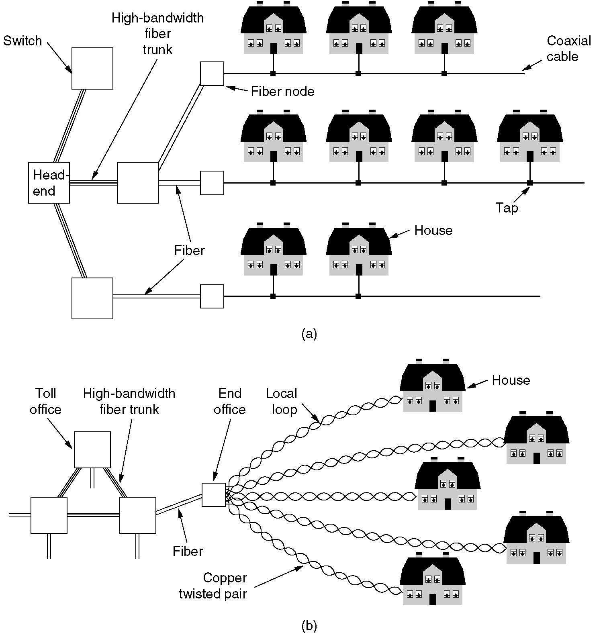
Internet over Cable
Cable television

Slide 7
Internet over Cable
The fixed telephone system.

Slide 8
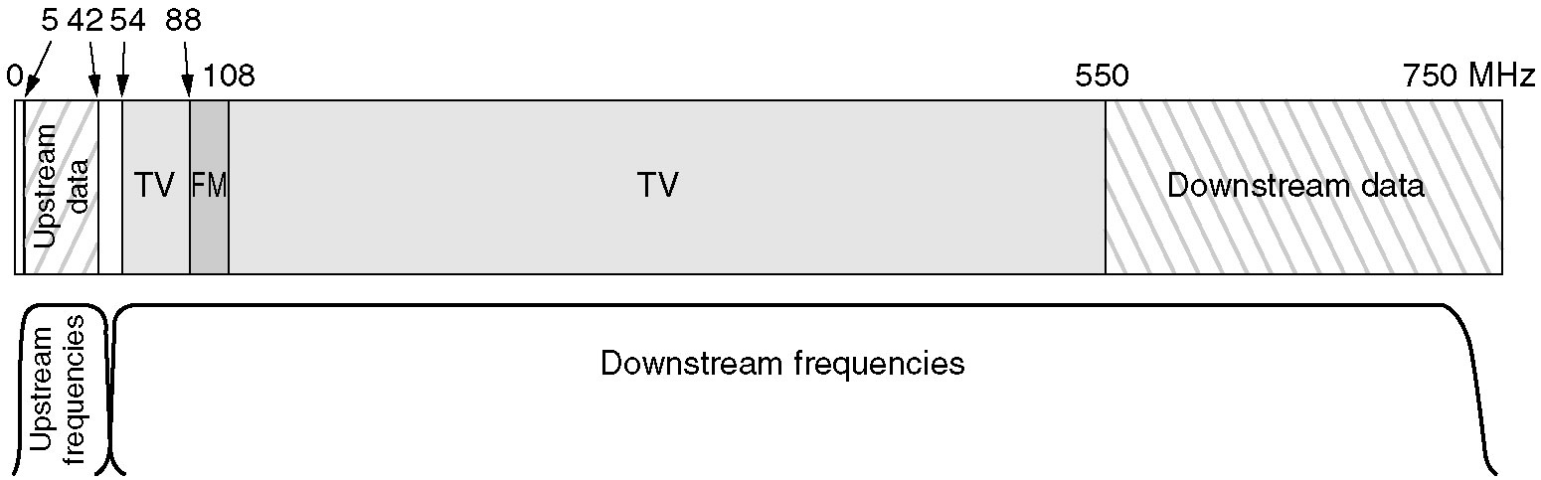
Spectrum Allocation
Cable television channels in North America occupy 54-550 MHz region
  FM radio occupies 88-108 MHz
  Channels are 6 MHz wide including guard bands
Cable television in Europe starts at 65 MHz
  Channels are 6-8 MHz
Frequency allocation in a
typical cable TV system used
for Internet access

